Slide 1
Intro to Reverse Engineering with Ghidra: Taming the Dragon
Christopher Doege

Slide 2

About me…
•CTF player
–Nasa Rejects
•UTSA Alumni
Enjoy Crypto and Reversing

Slide 3
Downloading Binaries
https://github.com/cdminigun/BSidesSATX-2021
WARNING
Several binaries for practicing RE
Actual malware contains real malware
Do not detonate on a windows host
Password is infected
Not liable for any damage caused to machines

Slide 4
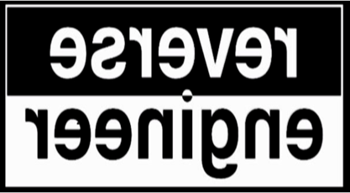
What is Reverse Engineering?
–Many Forms (Focusing on Binary Reverse Engineering)
–Compiled code -> ASM
–Useful for figuring out how binaries work
•Malware, CTFs, VR, etc

Slide 5
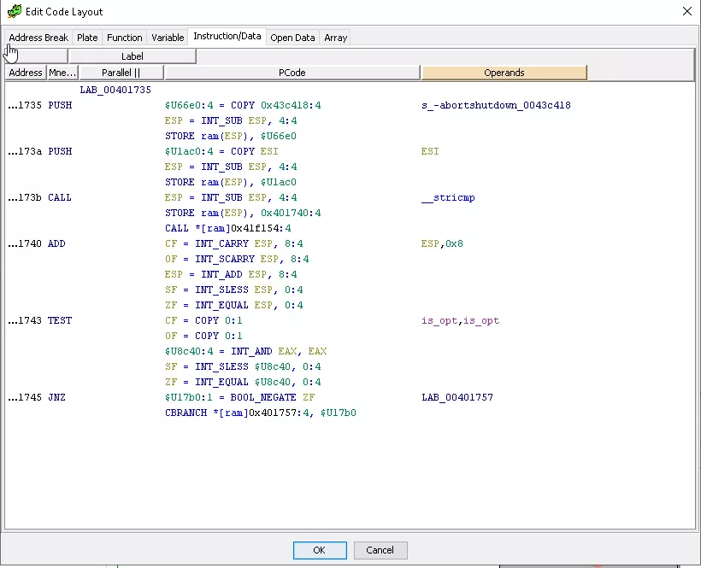
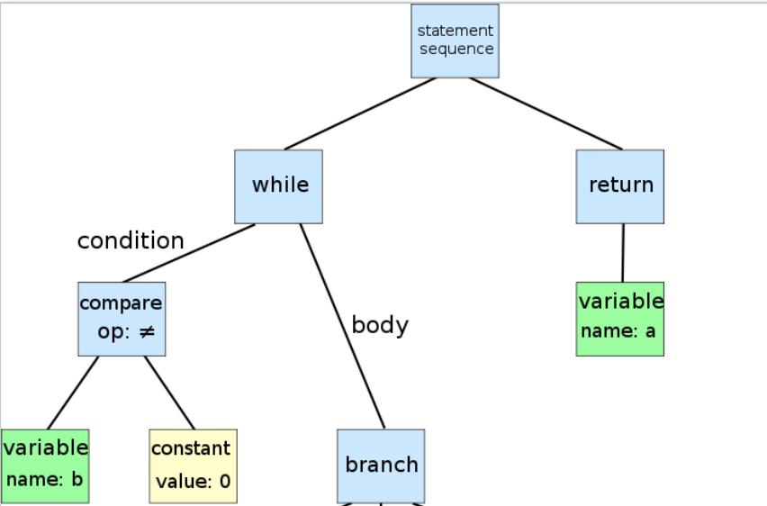
Introduction to Reversing Topics
RE:
Static Analysis
Dynamic
Disassembling
Byte-code → Assembly
Decompilation
ASM → IL → “C-like” Syntax
Notes:
EXPLAIN that this module provides an introduction to Ghidra and covers a variety of reversing topics. In this course, you will be further introduced reverse engineering, disassembling, and decompilation.

Slide 6
Static Analysis
Examining code without executing the program
Provide understanding of code structure and program flow
Limitations
Lack of contextual understanding
Unable to track indirect calls / dynamic code
Notes:
EXPLAIN that a static analysis is method of computer program debugging that is done by examining the code without executing the program. The process provides an understanding of the code structure, and can help to ensure that the code adheres to industry standards

Slide 7
Dynamic Analysis
Method of analyzing a binary through some form of execution
Goes hand-in-hand with static analysis
Utilize examinations from dynamic analysis to improve and speed up static analysis
Note
Ghidra does not have dynamic capabilities at this time
Notes:
EXPLAIN that dynamic analysis is a method of analyzing a binary through some form of execution. Dynamic analysis goes hand-in-hand with static analysis and we use examinations from dynamic analysis to improve and speed up static analysis. We will discuss more about dynamic analysis as we proceed.

Slide 8
Plan of Attack
Top Down
Start from program entry and work through it
High Level
Skim through functions and identify common ones
Sys Calls / Function Calls
Trace program up from interesting functions
Guided
Utilizing dynamic analysis to guide reversing
Notes:
EXPLAIN the static analysis methodology as the top-down plan of attack.

Slide 9
Common Pitfalls
Going down the “rabbit hole”
Reversing functions that are not reachable
Function does not decompile or decompile correctly
Not saving your database
Notes:
DESCRIBE the common pitfalls related to the static analysis methodology.

Slide 10
Overview
Converts machine code to assembly
Recognizes the start and end of functions
Recognizes jumps/calls to functions
Recognizes strings and data areas
Remembers a user’s labels and comments
Graphs program flow
Notes:
DESCRIBE static analysis techniques performed using Ghidra:
Converts machine code to assembly
Recognizes the start and end of functions
Recognizes jumps/calls to Windows functions
Recognizes strings and data areas
Remembers a user’s labels and comments
Graphs program flow

Slide 11
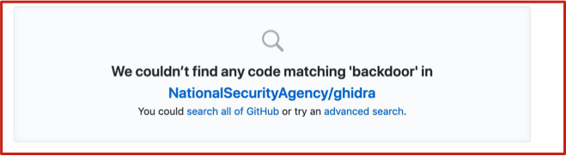
What is Ghidra?
“Gee-druh”
Software reverse engineering tool with version management / decompilers
Repo on github with active contributions / maintainers
Multi-platform (Linux, OSX, Windows)

Slide 12
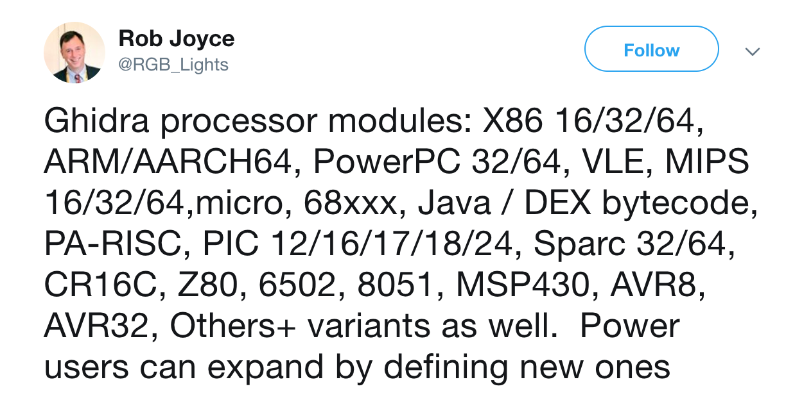
Supported Architectures
Notes:
DESCRIBE supported architectures.

Slide 13
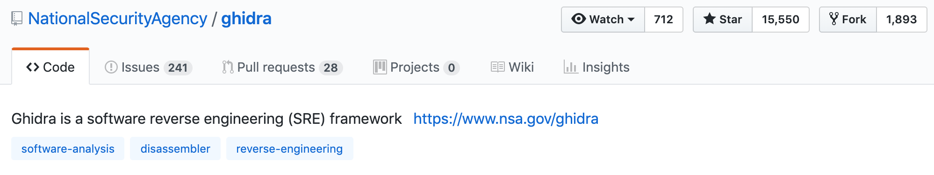
Downloading Ghidra
https://ghidra-sre.org
https://github.com/NationalSecurityAgency/ghidra
Can build from source
Notes:
DISCUSS how to access Ghidra downloads.

Slide 14
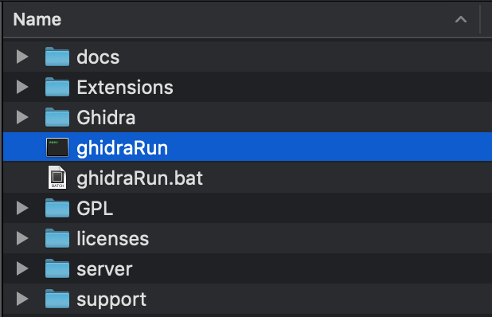
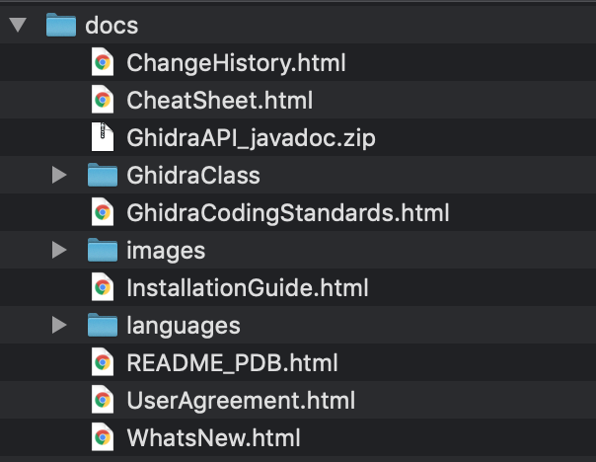
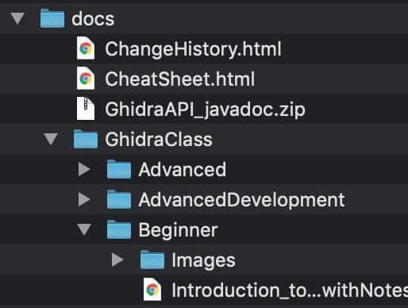
Ghidra Folder Layout
Notes:
DESCRIBE Ghidra folder layout and features.

Slide 15
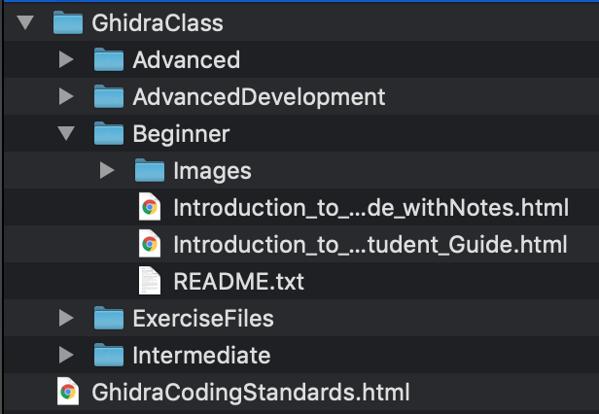
Ghidra Trainings
Notes:
DESCRIBE Ghidra trainings.

Slide 16
Useful Plugins
https://github.com/0ffffffffh/dragondance
Like lighthouse for Ghidra
Used to visualize and manipulate binary code coverage
https://gist.github.com/adulau/a3a0eefb7828d52747a9d247a82eeeef
“Ghidra Community”
List of plugins/cpu extensions for ghidra
https://github.com/daenerys-sre/source
Allows execution of ida scripts in ghidra and ghidra scripts in ida
Notes:
POINT OUT the useful Ghidra plugins and briefly describe how they are used.

Slide 17
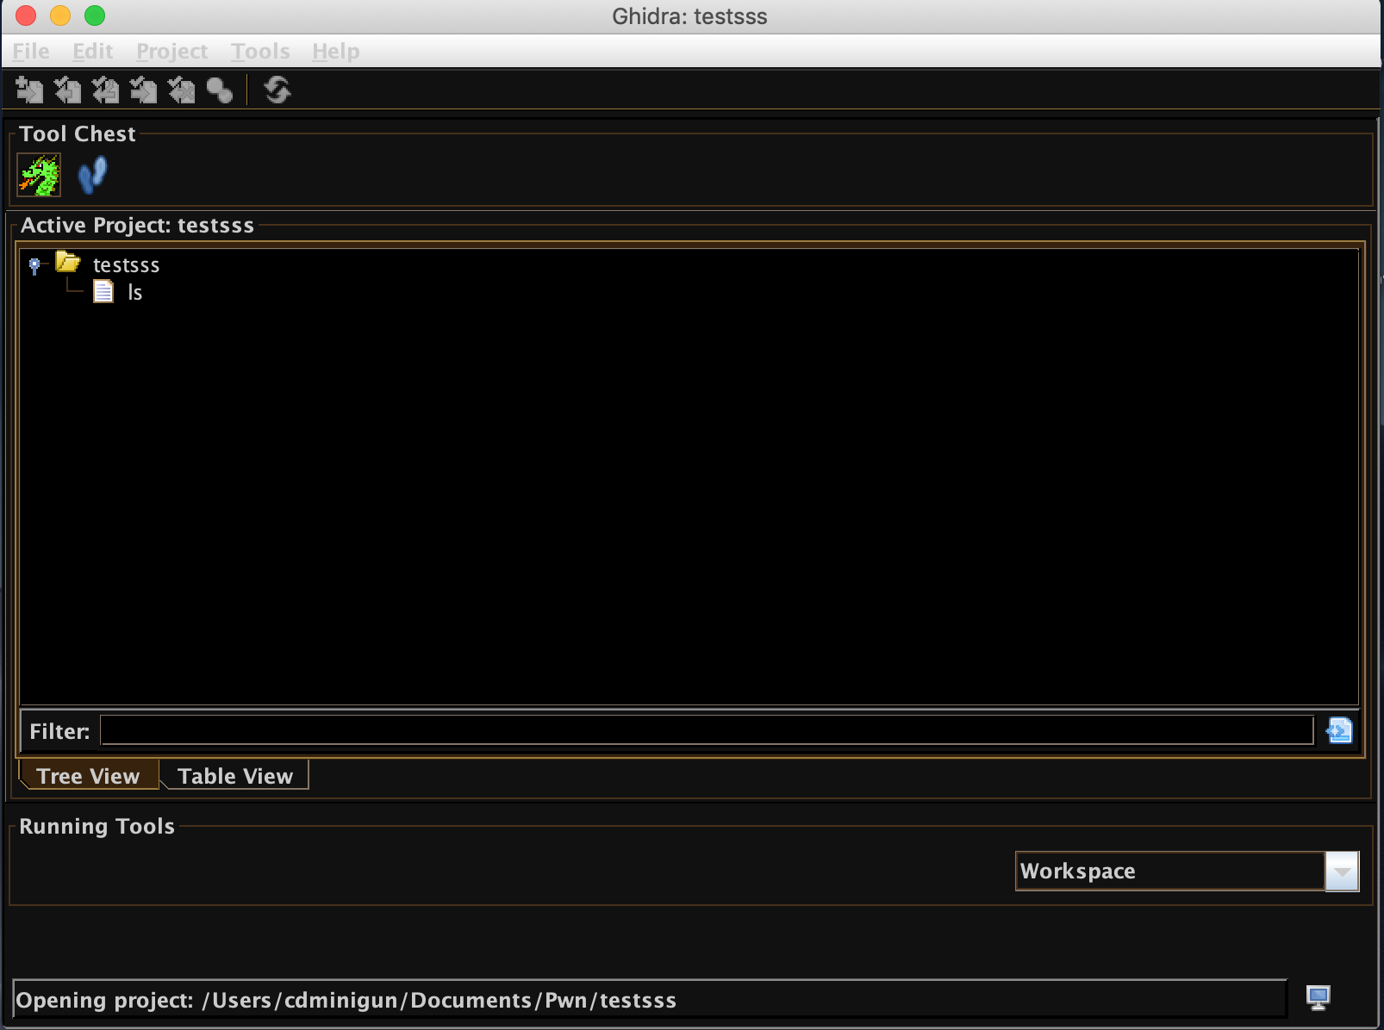
Useful Features
Themes and configurations
Version tracking
Binary diffing
Mod + e
Notes:
DEMONSTRATE useful features including themes and configurations, version tracking, binary diffing and Mod+e.

Slide 18
Server Collaboration
Git like collaboration
Commit changes to the database back to the server
Review changes made by others
Version history
Use cases
Useful for CTFs
Mentoring for RE
Group malware reversing efforts
Notes:
DESCRIBE server collaboration features (briefly). Note that this will not be used during the workshop, but is a useful feature.

Slide 19
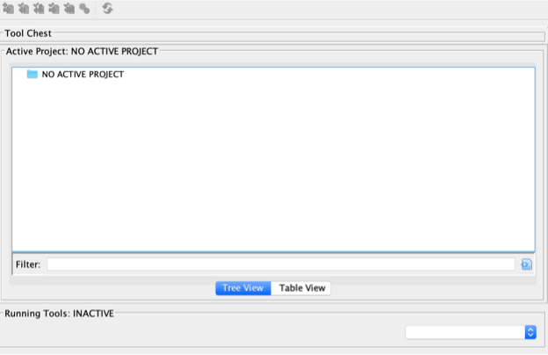
RE with Ghidra
Notes:
DEMONSTRATE performing RE with Ghidra and basic navigation.

Slide 20
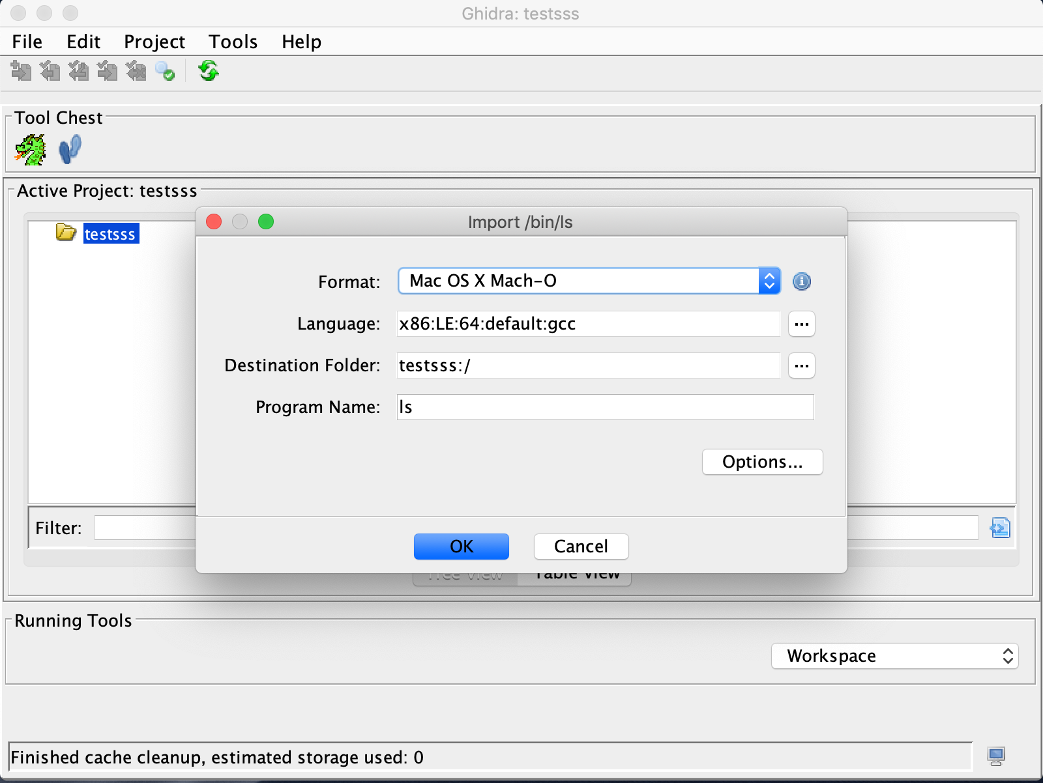
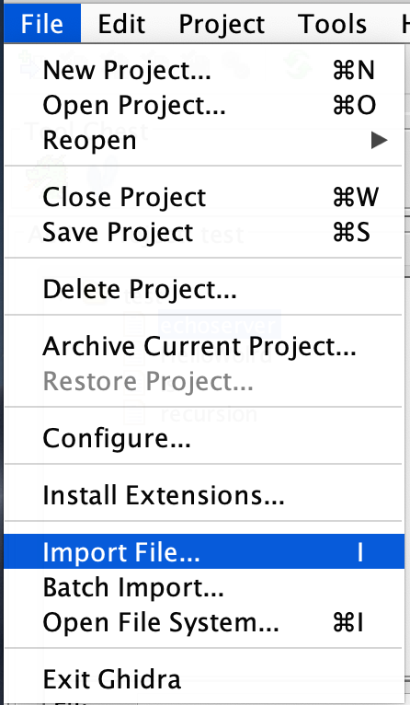
Add Binaries
Notes:
DEMONSTRATE performing RE with Ghidra and basic navigation.

Slide 21
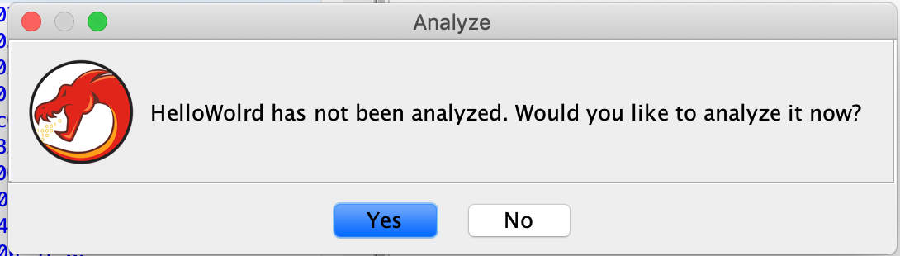
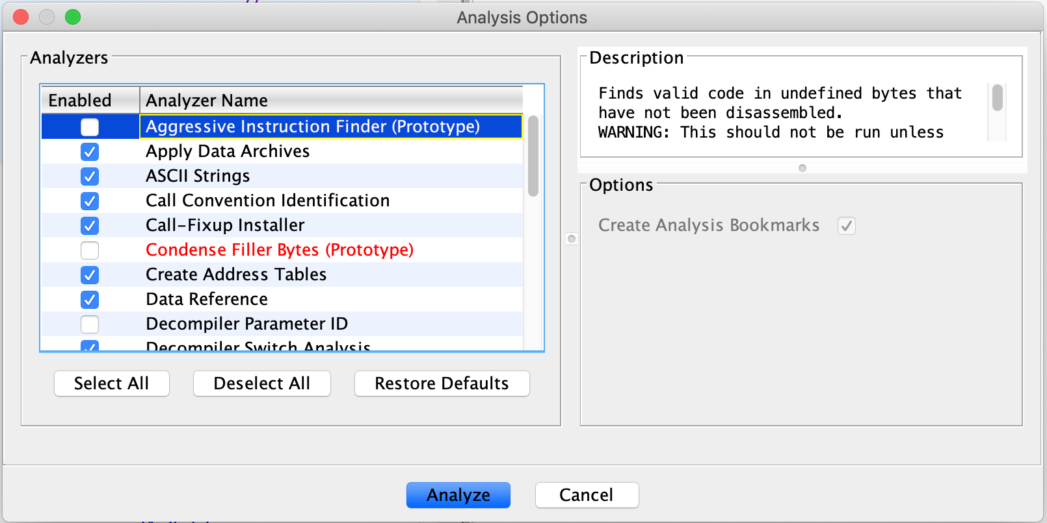
Automated Analysis
Notes:
DESCRIBE the Ghidra automated analysis options.

Slide 22
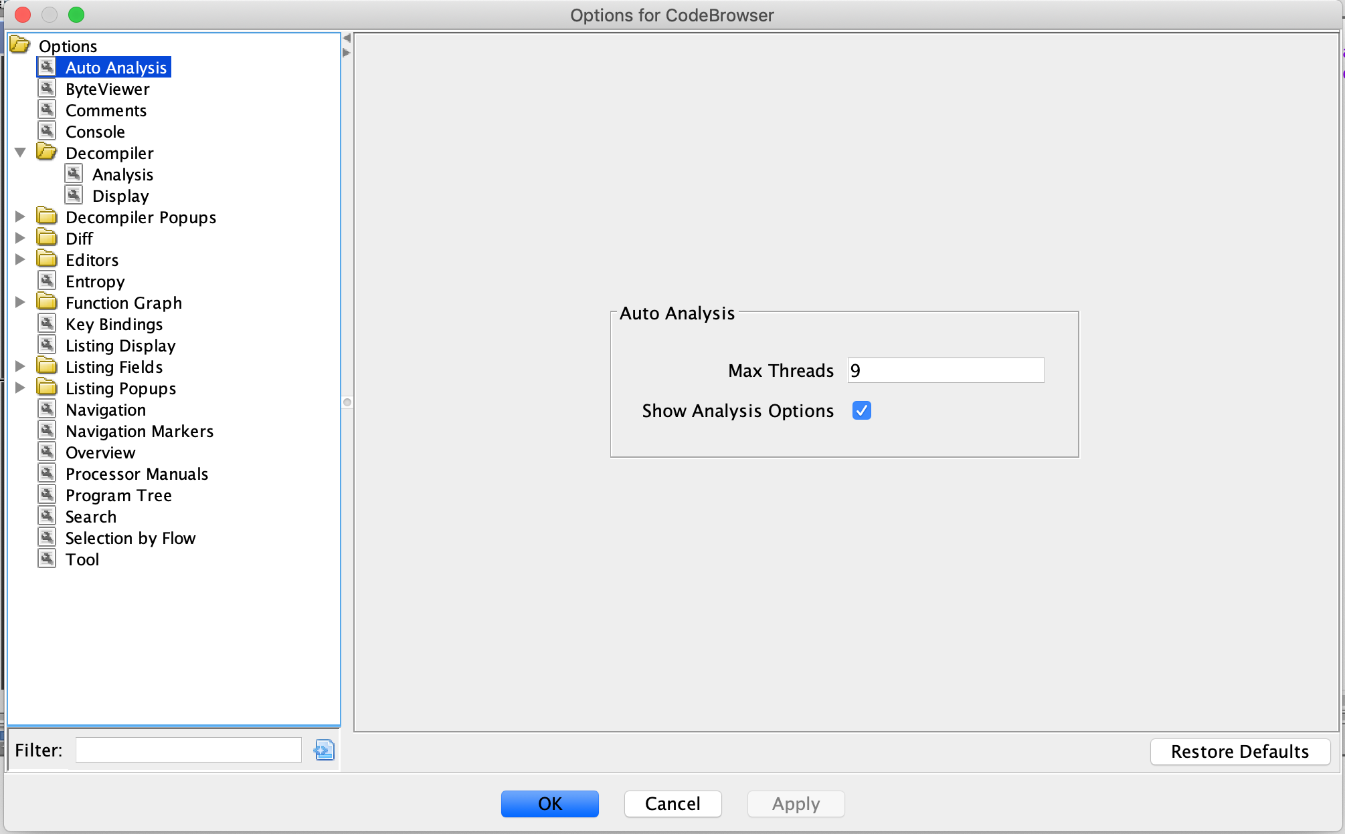
Tool Options
Notes:
DESCRIBE the Ghidra tool options.

Slide 23
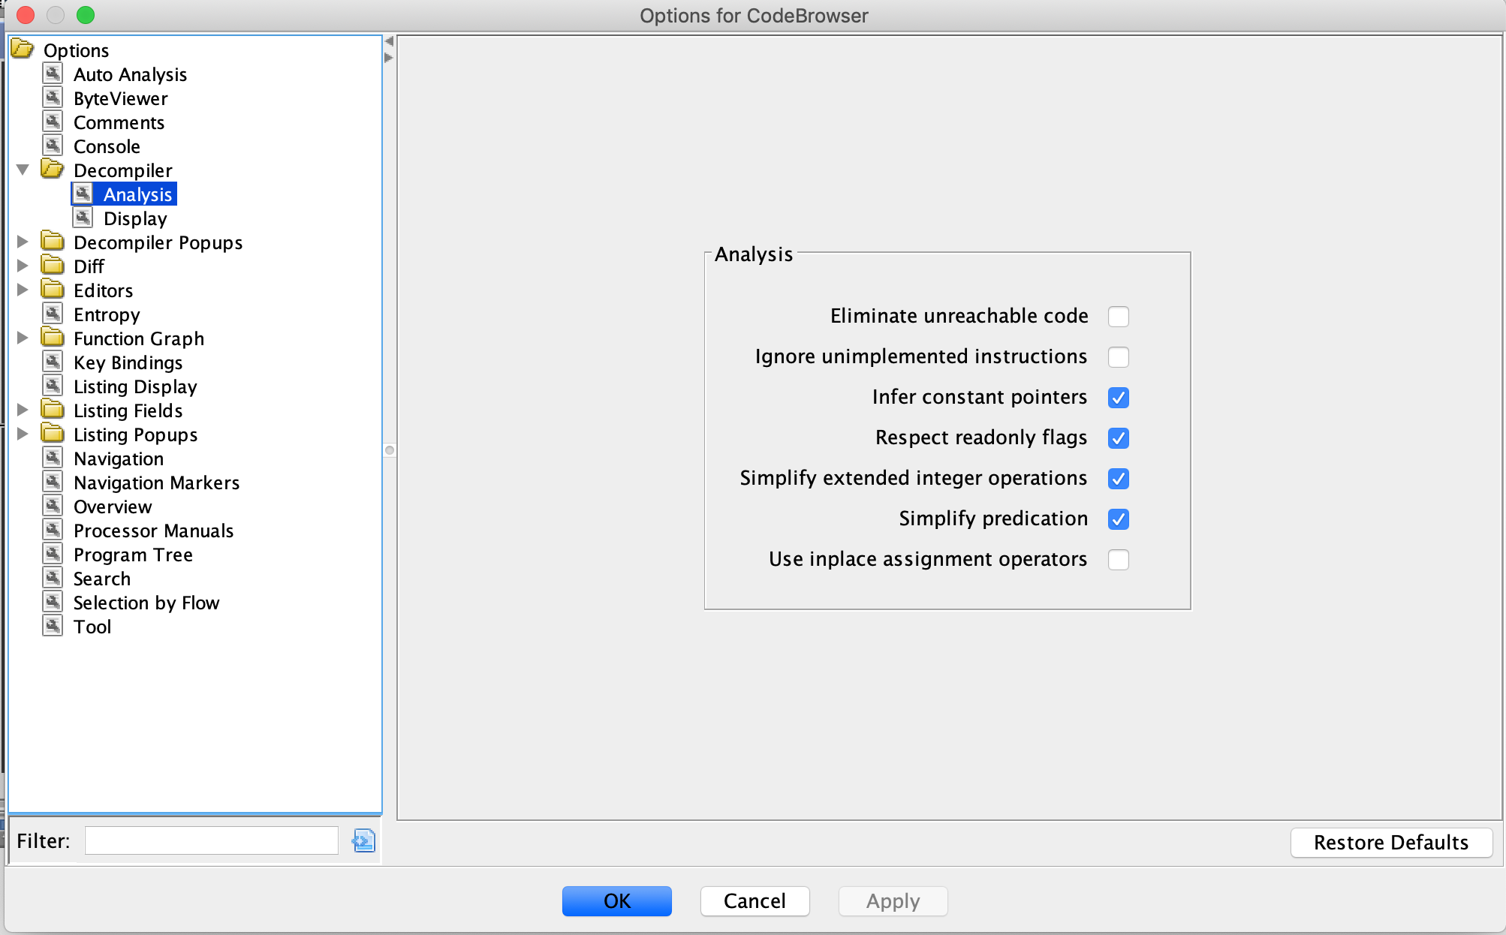
Modifying Analysis
Notes:
POINT OUT options used to modify the analysis displayed on the Options for CodeBrowser screen.

Slide 24
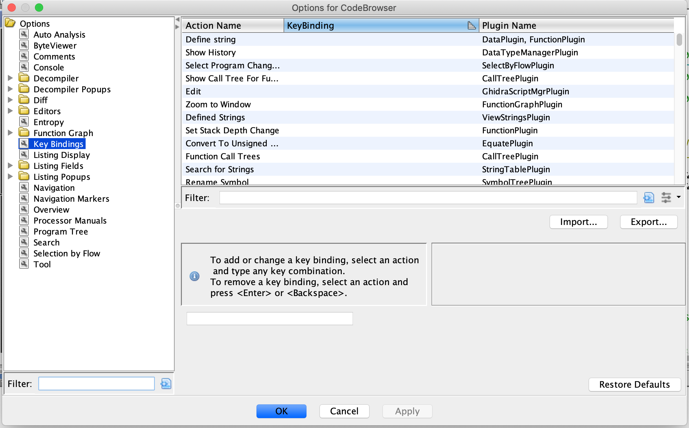
Modifying Key Bindings
Notes:
DEMONSTRATE modifying key bindings. Instructor Note: This screen has a blurb mentioning “select an action and type a key combination” which will work on OSX. If you click in the text box that has the key binding (or is empty) and type it in there, you can set the key binding. However, if you do this from hitting F4 while hovering over a tooltip, this screen allows you to type a keypress to replace the specified key binding.

Slide 25
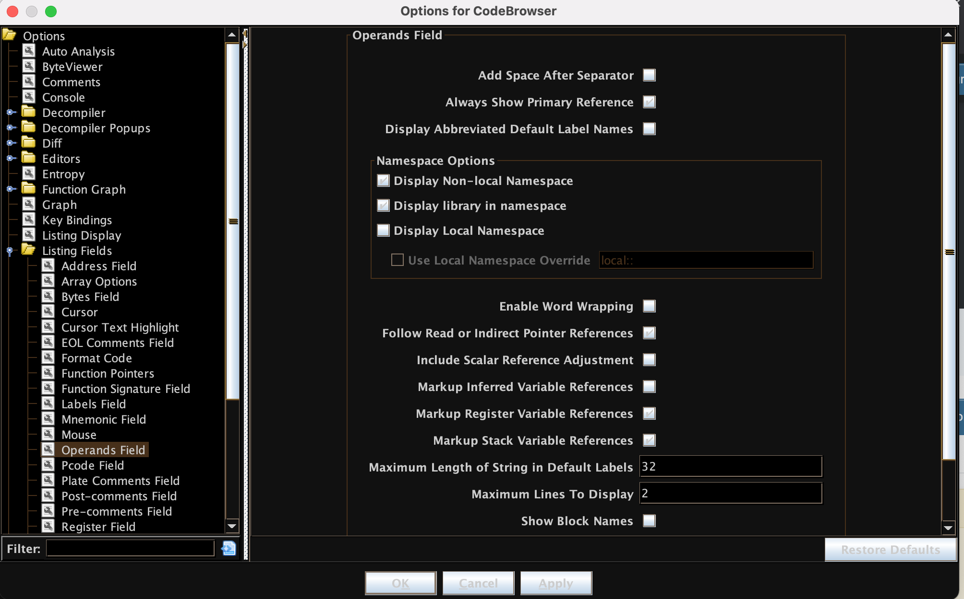
Modifying Disassembly Options

Slide 26
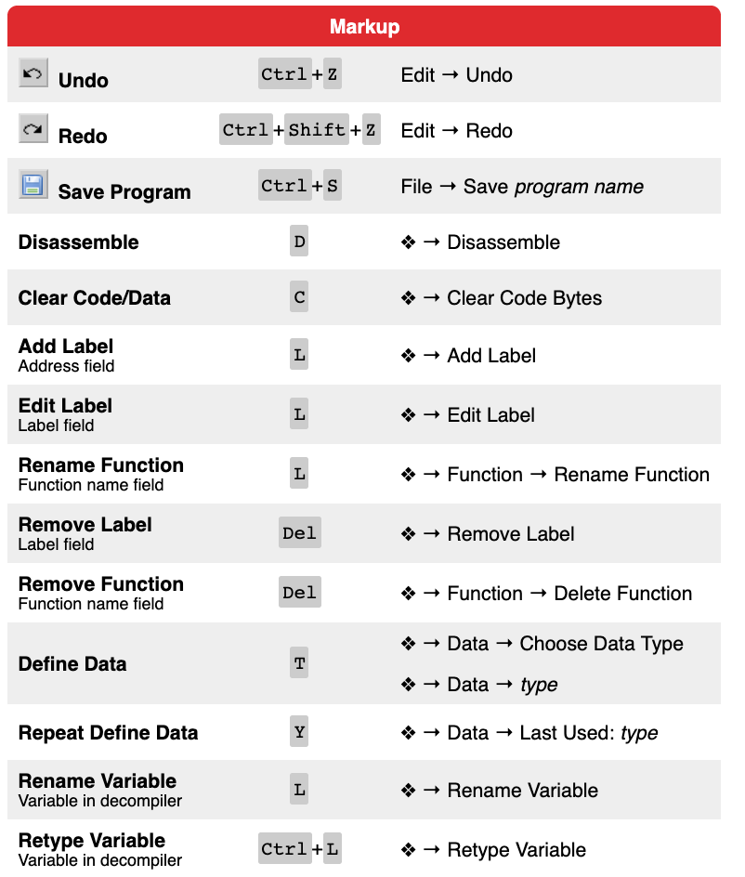
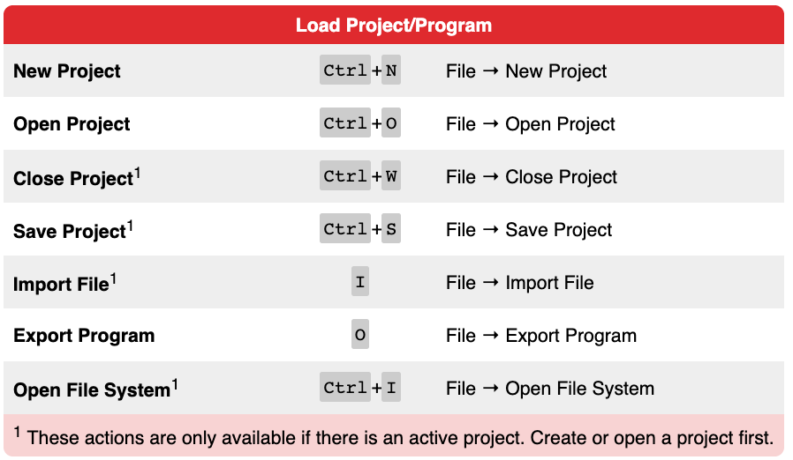
Common Keybindings
Notes:
POINT OUT the common keybindings. Briefly highlight Markup and Load Project/Program actions.

Slide 27
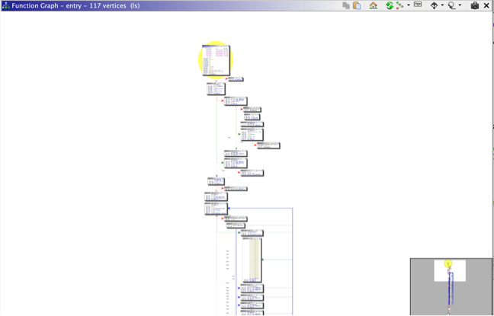
Graph View
Notes:
DEMONSTRATE the use and features of Ghidra’s Graph View.

Slide 28
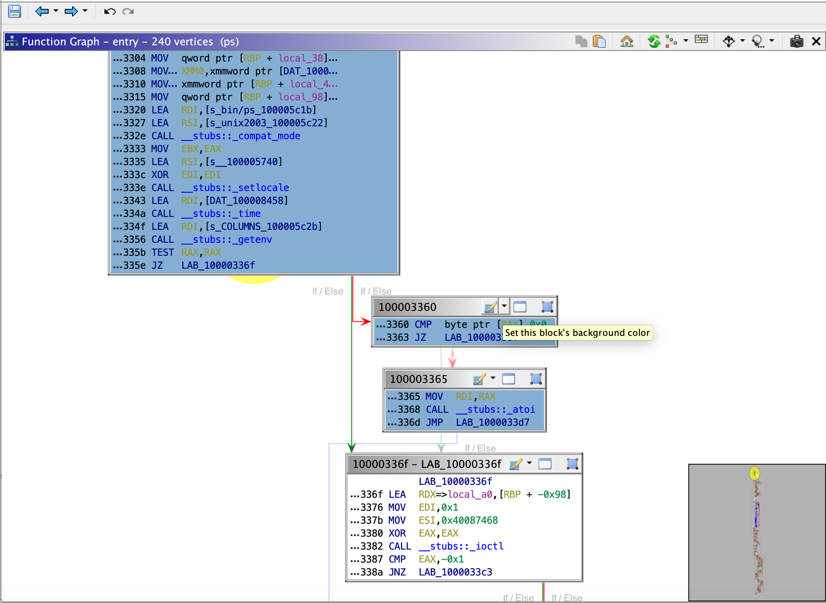
Graph Markup
Notes:
DESCRIBE the graph markup feature.

Slide 29
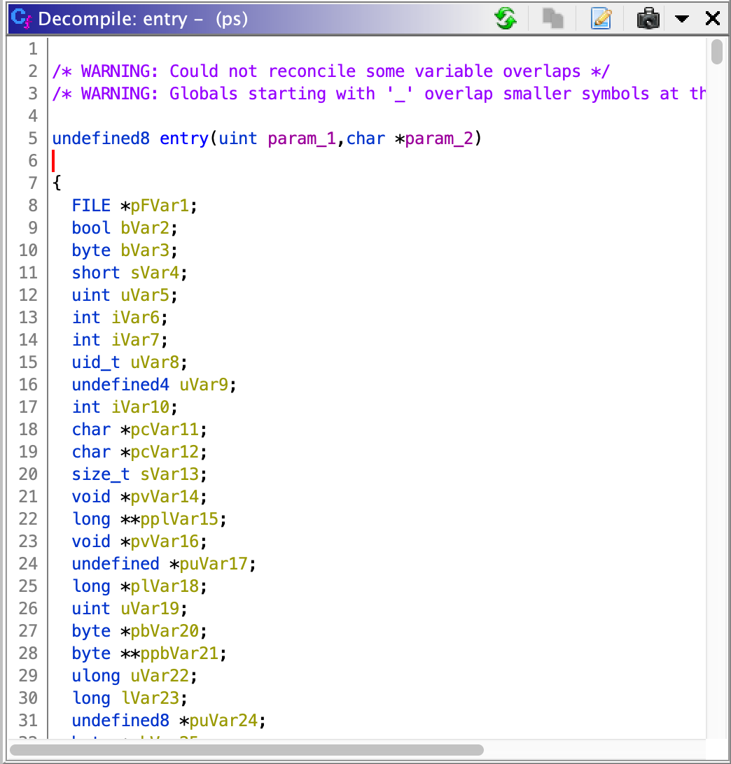
Decompiler
Notes:
DESCRIBE using the Decompile screens and functions. This is continued on the following slide.

Slide 30
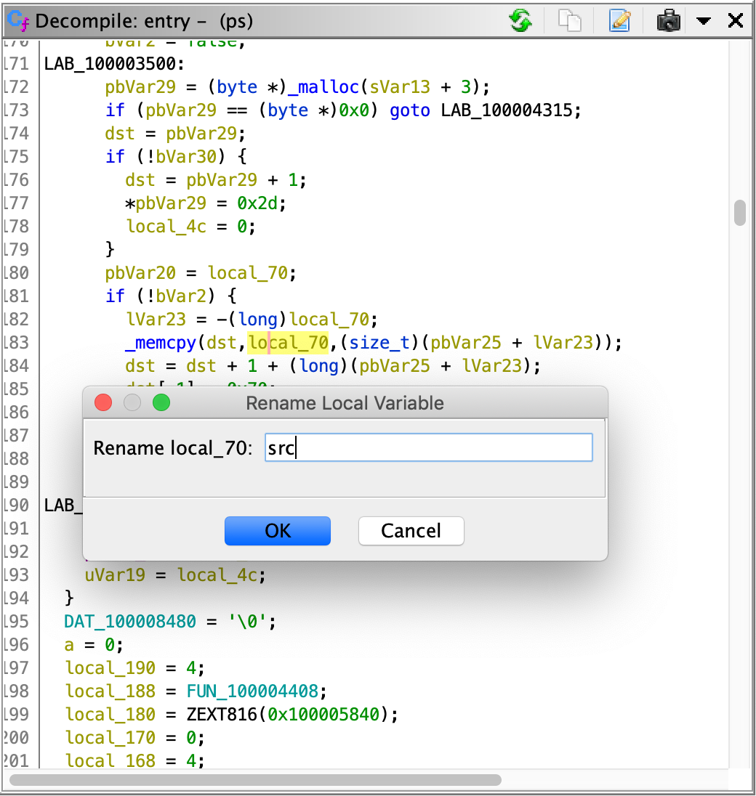
Decompiler Markup / Labeling

Slide 31
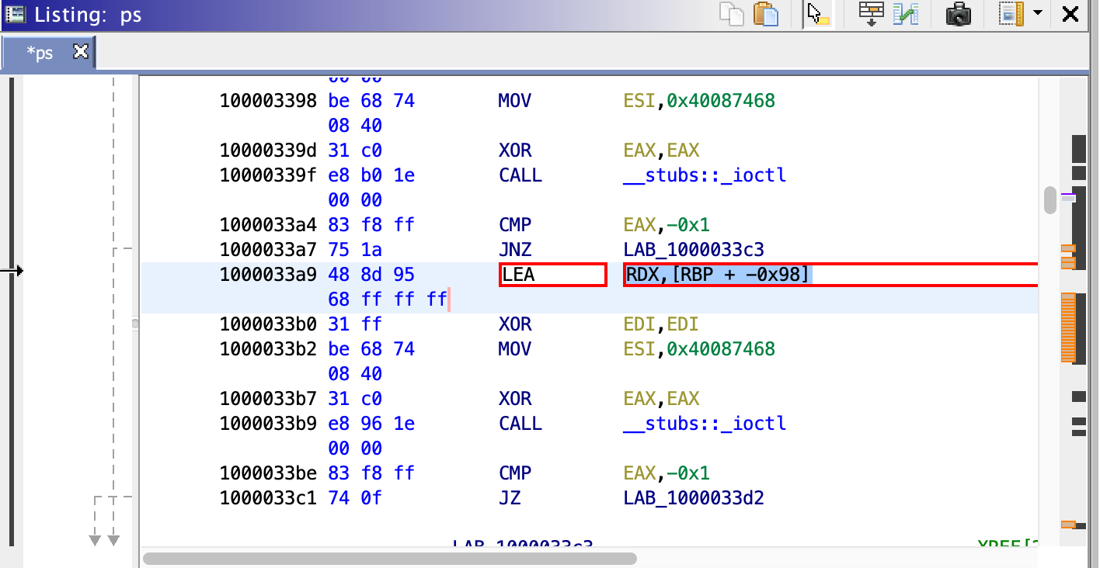
Patching Binaries

Slide 32
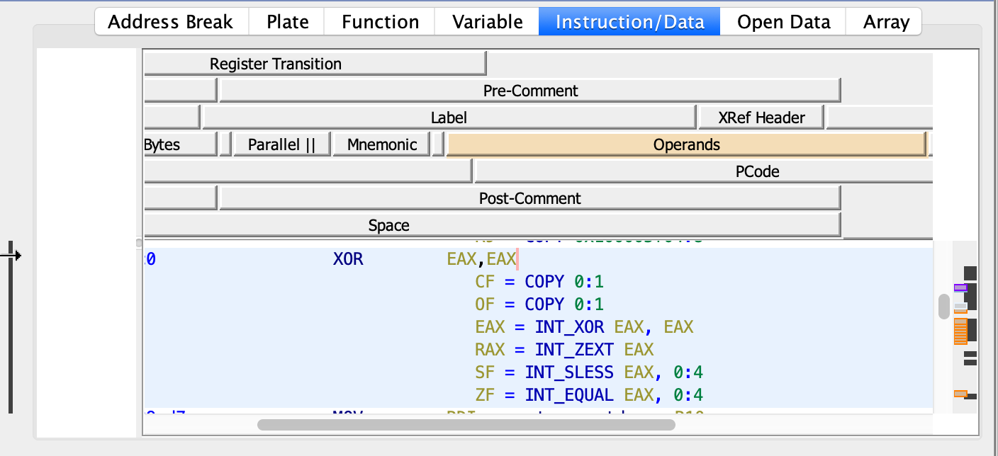
P-Code
P-Code is Ghidra’s intermediate language (IL) / Intermediate Representation (IR) for ASM
Generated by SLEIGH
Ghidra’s processor specification language
Notes:
EXPLAIN that P-Code is Ghidra’s IL/IR for ASM which is generated by SLEIGH, Ghidra’s processor specification language.

Slide 33
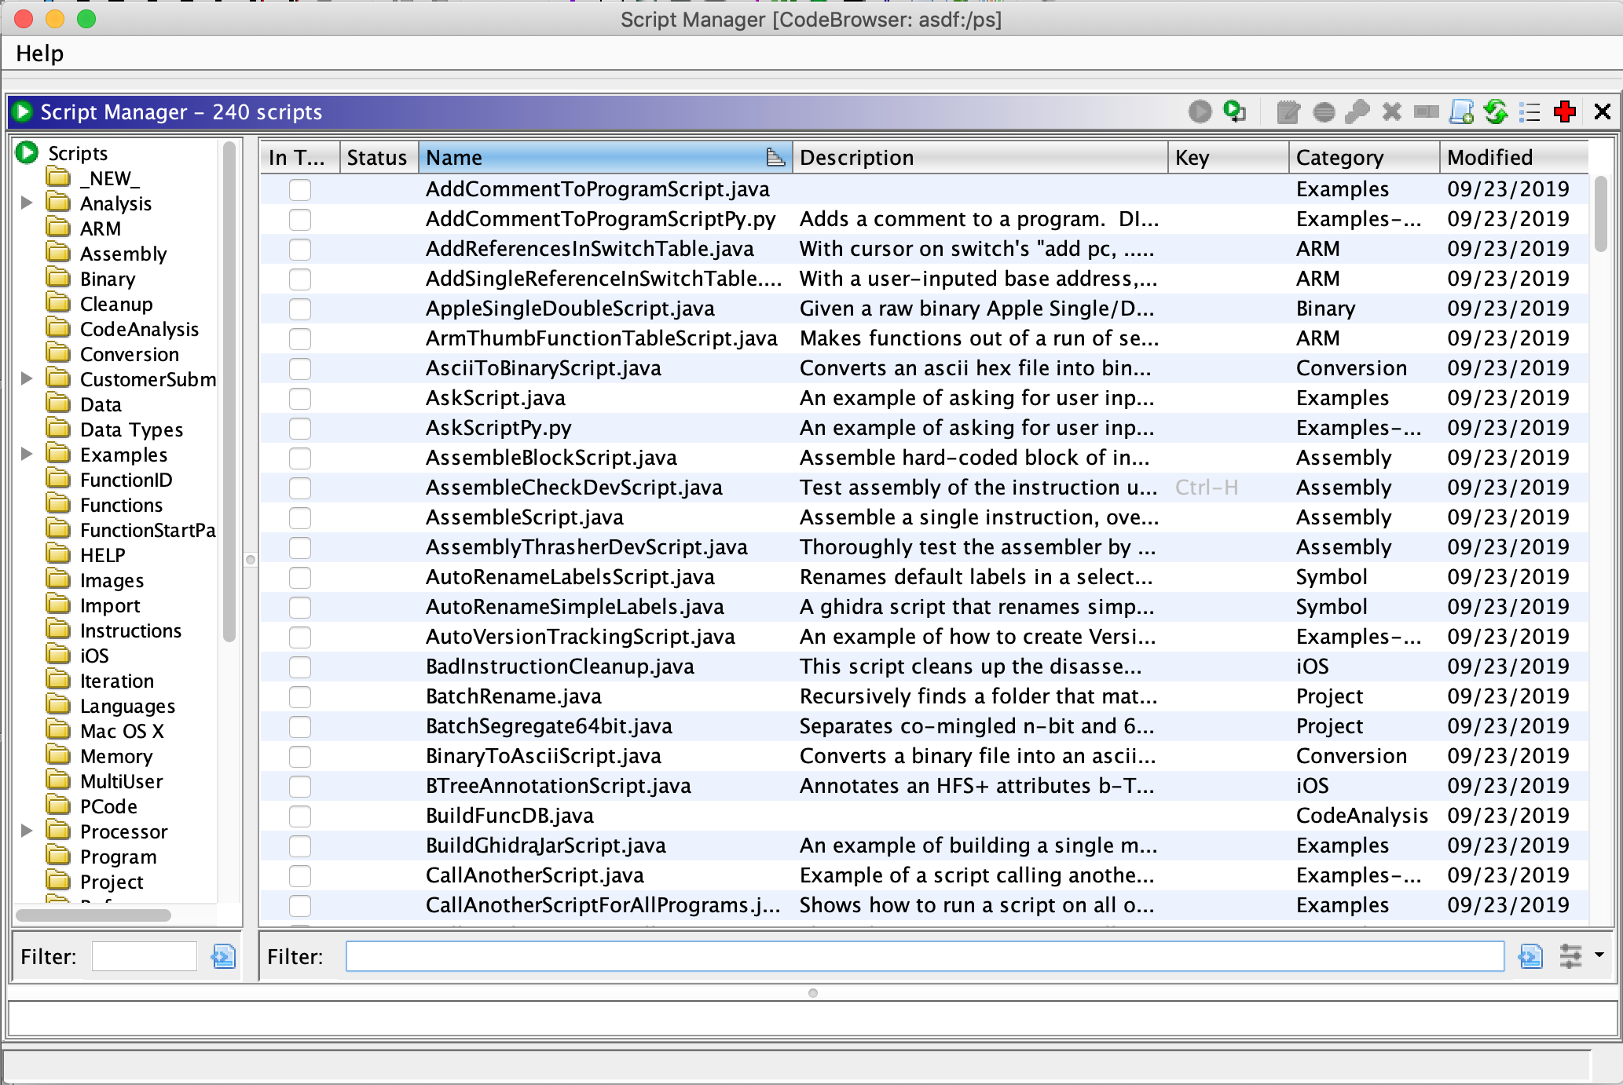
Script Manager
Notes:
DEMONSTRATE key features of the Ghidra Script Manager.

Slide 34
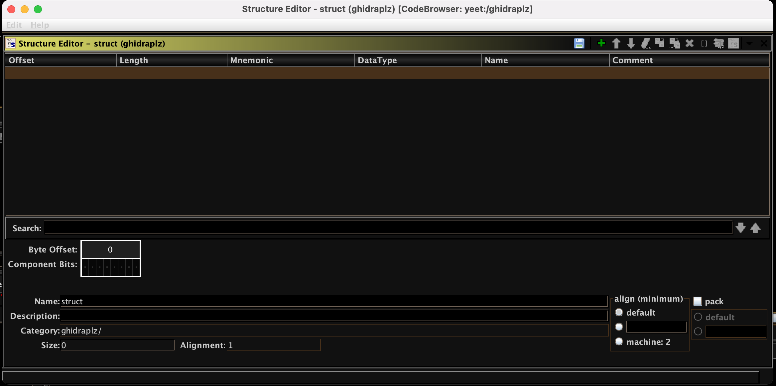
Data Type Editing / Structures

Slide 35
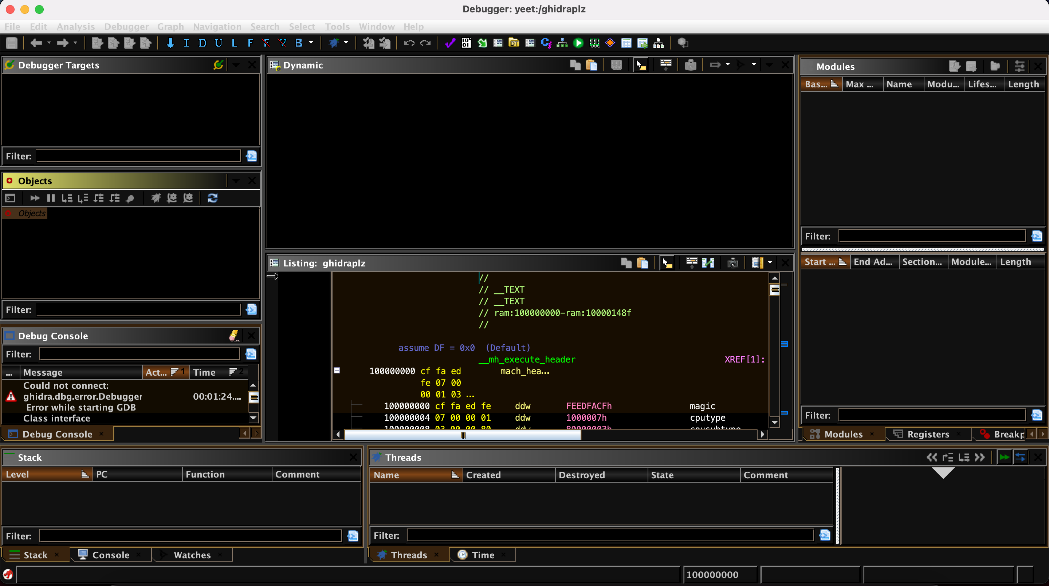
Debugging - Beta

Slide 36

Demo Binaries
Notes:
DEMONSTRATE several binaries in Ghidra.

Slide 37

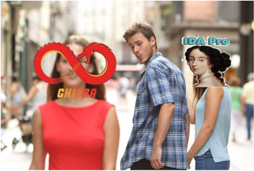
Memes

Slide 38
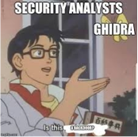
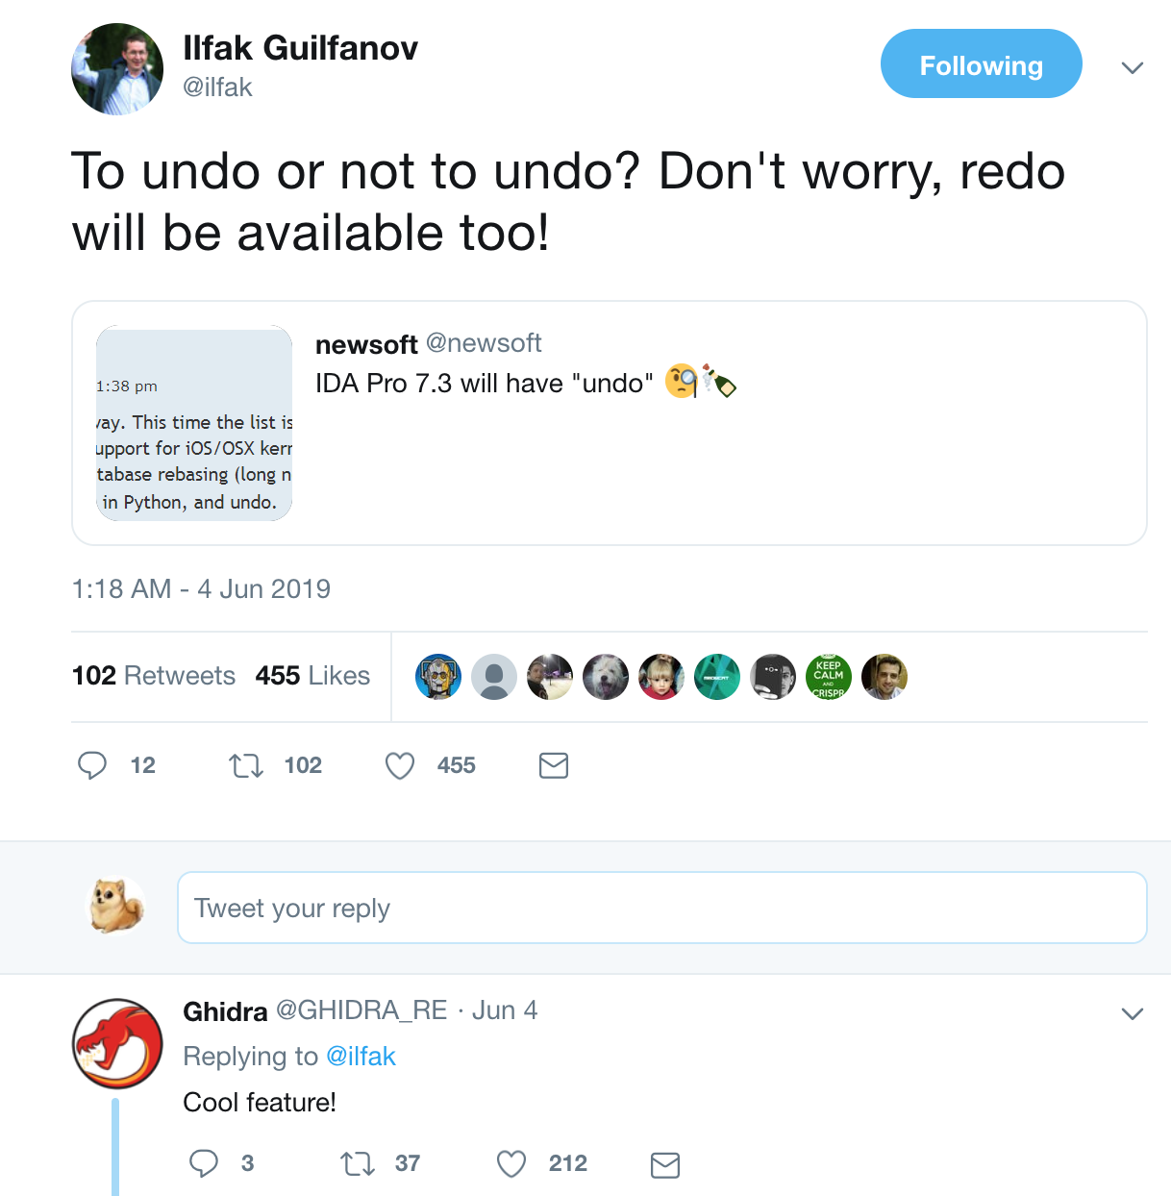
Memes Cont..

Slide 39
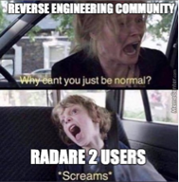
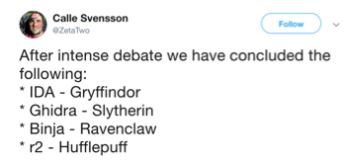
Memes Cont……..

Slide 40
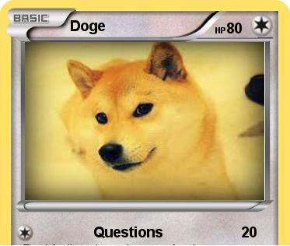
Conclusion / Questions?

Slide 41

Thank You!
•@Chris_Doege Doge on discord

